Slide 1

Software Developers - Mitchell A. Gideon I .

Slide 2

The problem
Who is Futwell Technologies?
Futwell Technologies is a company focused on making the Earth more sustainable and safer.
They focus on:
They make Apps that:
They contribute to a more sustainable future.
Technologies and Innovations
Bring people together to clean up the environment.
Educate people on making the environment and animals better
“A third of young people (10 to 19) said they felt alone or lonely some of the time”
Notes:
Gideon

Slide 3
The problem
Futwell realised that sustainability wasn’t just about the ENVIRONMENT or our ANIMALS.
Gov.uk
next generation
“A third of young people (10 to 19) said they felt alone or lonely some of the time”
Teenagers
Notes:
Gideon

Slide 4
Our Solution
Notes:
Mitchell

Slide 5
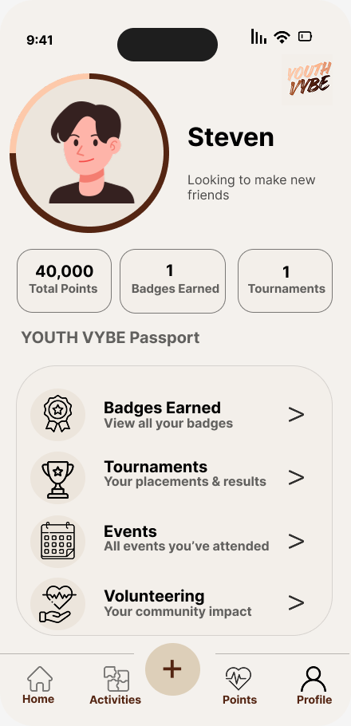
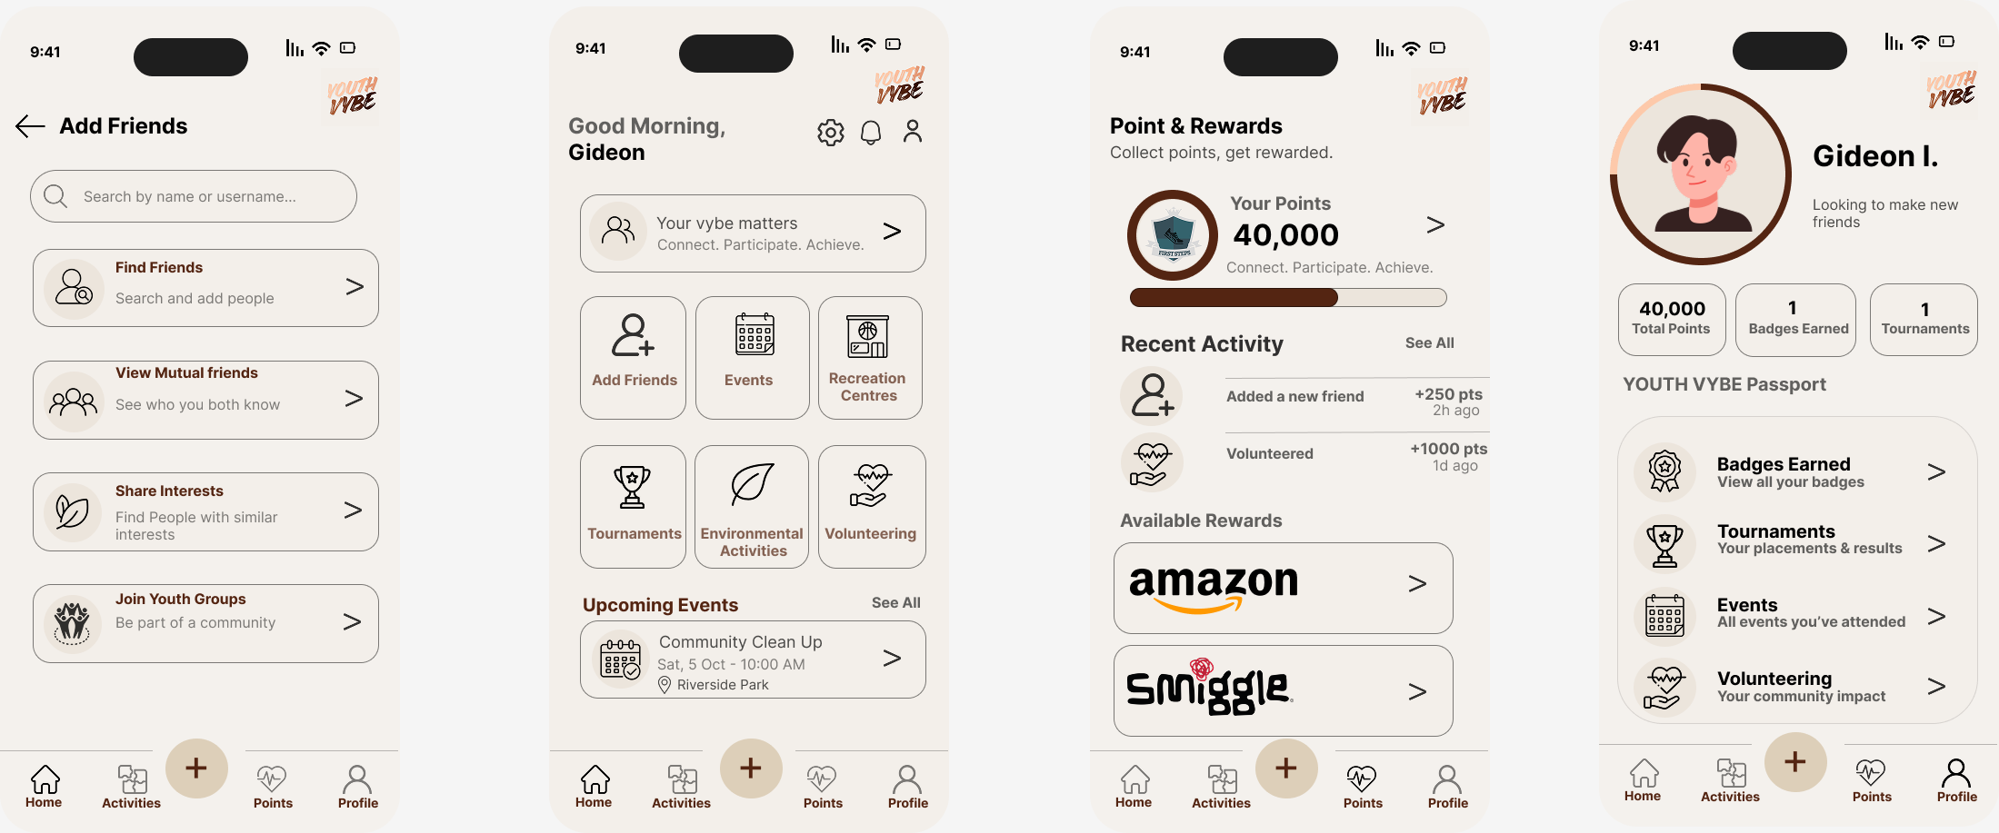

Our Solution
We identified an opportunity to use Futwell's foundation to create something specifically for young people.
Our aim is to give teenagers a safe space to connect, discover activities, join events, volunteer, and build positive experiences together.
We created A social platform designed for teenagers aged 13–17
Notes:
Mitchell

Slide 6
How Youth Vybe Works
We identified an opportunity to use Futwell's foundation to create something specifically for young people.
Our aim is to give teenagers a safe space to connect, discover activities, join events, volunteer, and build positive experiences together.
We created A social platform designed for teenagers aged 13–17
Add Friends
Notes:
Gideon

Slide 7
Features of Youth Vybe
Find your Vybe
Add Friends
View mutual friends
Join youth groups
Share interests
Notes:
Gideon

Slide 8
Features of Youth Vybe
Discover & Participate
Events
Recreation Centres
Volunteering
Environmental Activities
Notes:
Gideon

Slide 9
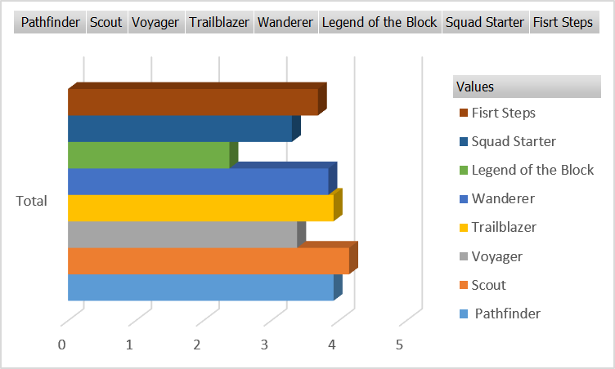
Features of Youth Vybe
Point & Badge System:
Instead of Likes → Followers → Popularity Youth Vybe focuses on: Participation → Contribution → Achievement
Make New
Friends
Progress through badges
0
Earn rewards
Participate in events activities
Notes:
Mitchell

Slide 10
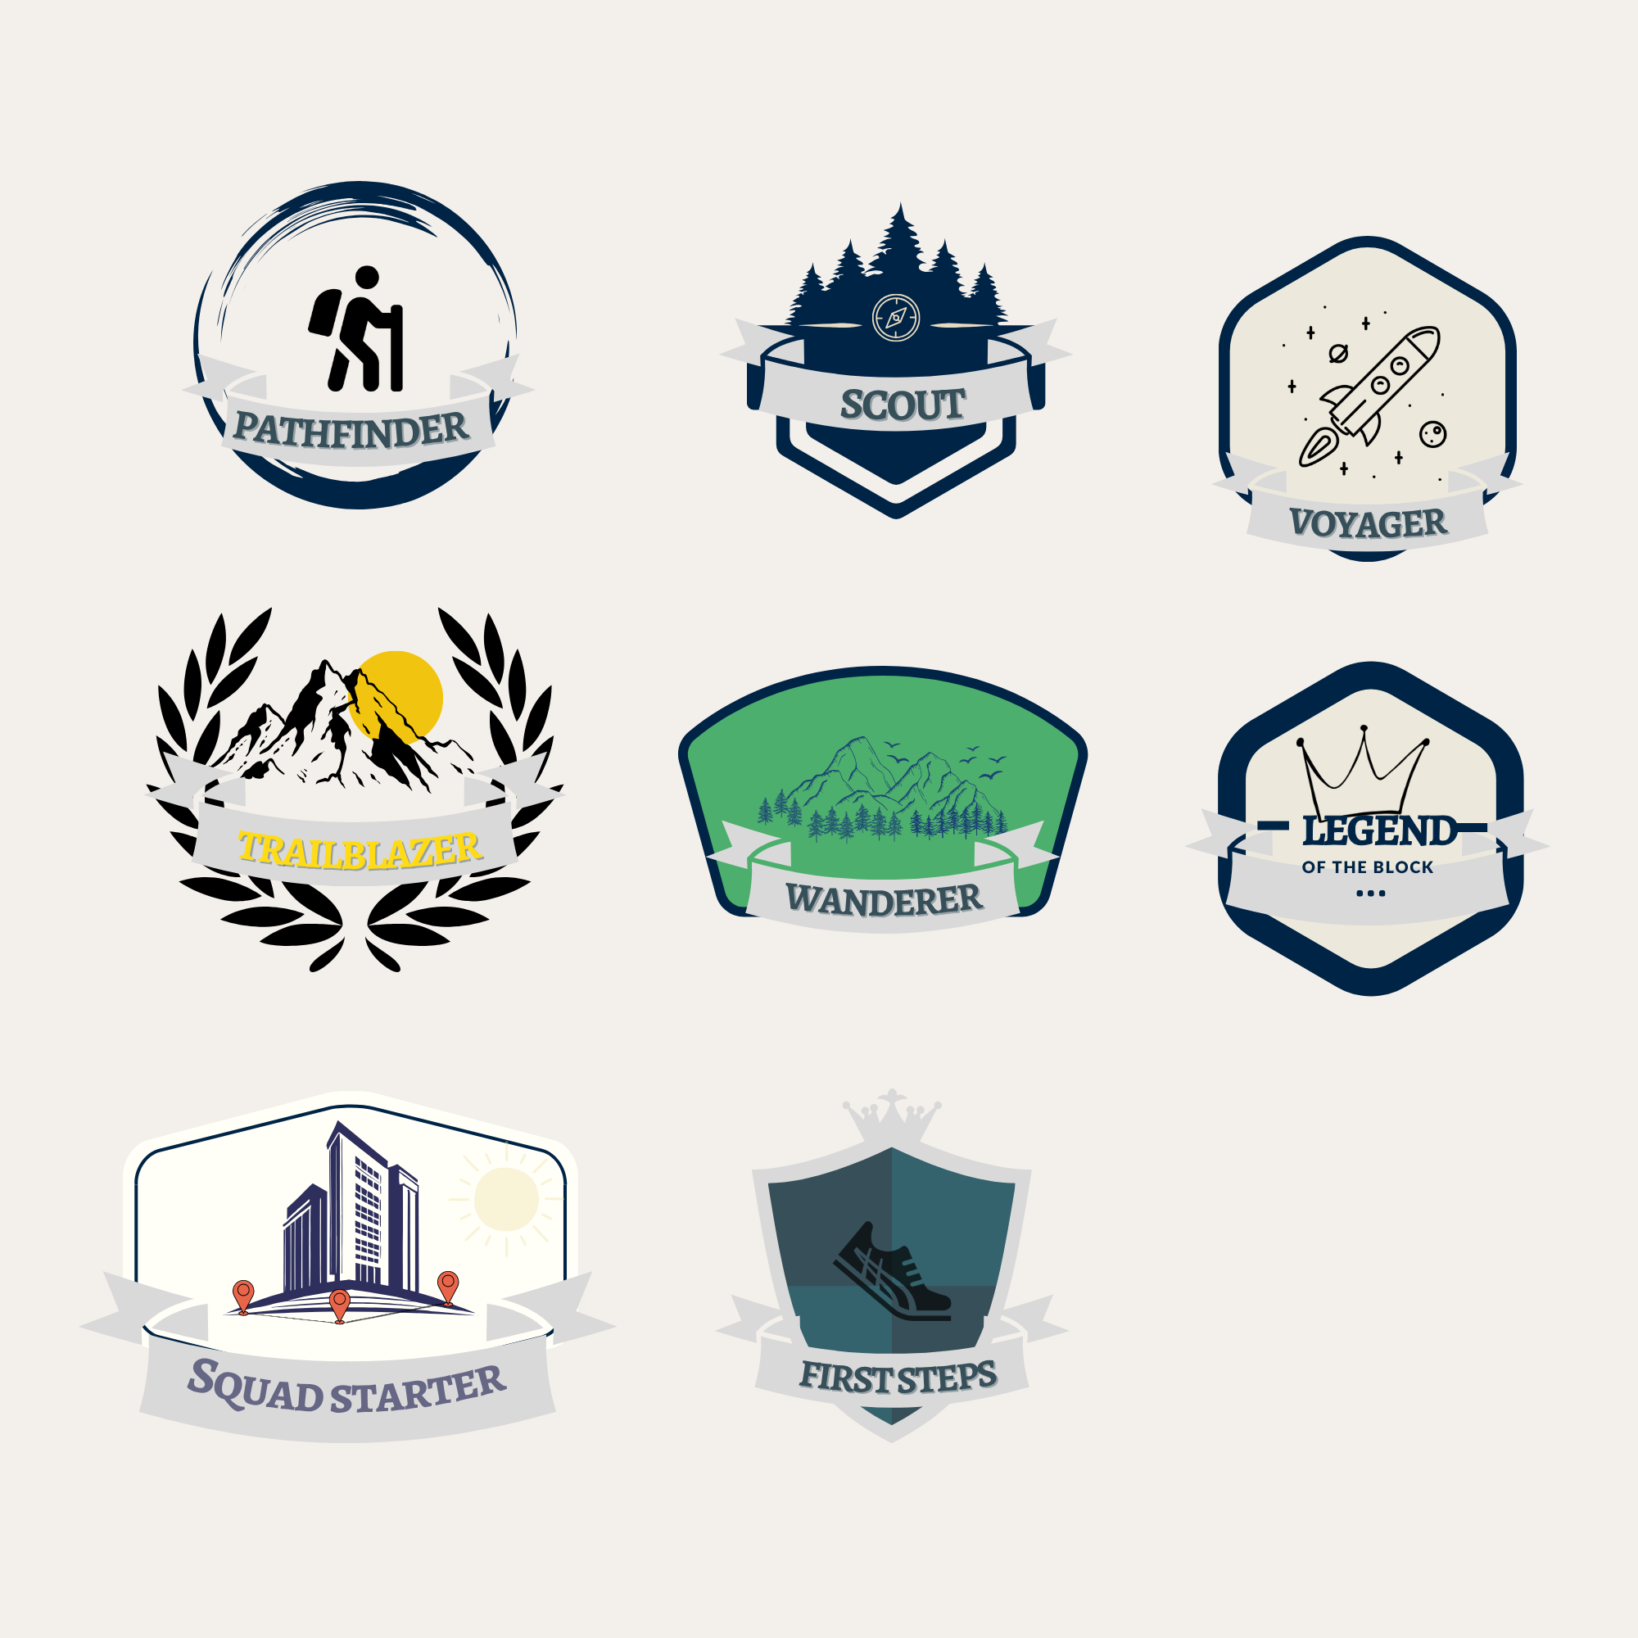


Badge Suggestions/Ideas
Feedback:
“one good consistent thing you guys have done are the names which are interesting, make sense and has real creativity”
“I think there should be some other additional colours and more details to specific badges such Legend of the block as - that badge is too minimal to be eye catching”
Notes:
Mitchell

Slide 11



Features of Youth Vybe
Youth Vybe Passport:
A personal record of experiences and achievements.
Build experiences
Develop skills
Feedback:
“one good consistent thing you guys have done are the names which are interesting, make sense and have real creativity”
Show what you’ve
achieved
“I think there should be some other additional colours and more details to specific badges such Legend of the block as - that badge is too minimal to be eye catching”
Notes:
Mitchell

Slide 12



Summer Tournament
Annual Youth Vybe Tournament
Once every summer, featuring:
Football
Volleyball
Basketball
Achievements can unlock badges and rewards
Teams can earn points based on tournament performance/placements
Notes:
Gideon

Slide 13




Why Invest in Youth Vybe?
Annual Youth Vybe Tournament
Once every summer, featuring:
Football
Volleyball
Basketball
An Opportunity for Sponsorships and Partnerships
Sponsors could support
Achievements can unlock badges and rewards
Teams can earn points based on tournament performance/placements
Drinks & refreshments
Tournament activities
Sports equipment /
event supplies
Prizes & rewards
Notes:
Mitchell

Slide 14




Why Invest in Youth Vybe?
Why Invest in Youth Vybe?
An Opportunity for Sponsorships and Partnerships
An Opportunity for Sponsorships and Partnerships
Sponsors could support
What sponsors receive
Drinks & refreshments
Association with youth sport and community participation
Brand visibility at the event
Tournament activities
Sports equipment /
event supplies
Product opportunities and connections with a younger audience
Potential long-term sponsorship
Prizes & rewards
Notes:
Mitchell

Slide 15


Safety Features
Why Invest in Youth Vybe?
An Opportunity for Sponsorships and Partnerships
Moderation
Trusted Contacts
Blocking
Privacy
Age Verification:
Brand visibility at the event
Cautious and conscious verification designed to help confirm users belong in the 13–17 community.
Association with youth sport and community participation
The ICO says hard identifiers such as passports can be used in some cases but shouldn’t be required unless truly necessary.
Product opportunities and connections with a younger audience
Potential long-term sponsorship
Users would have to use an identification document with their date of birth if reported for age related issues.
Notes:
Mitchell

Slide 16




Conclusion
We were tasked by Futwell to make, young people a part of their sustainable future
We used our computational thinking, creative minds and software skills to develop Youth Vybe
Youth Vybe connects teens to people and opportunities that can build real relationships and positive impact
Age Verification:
Cautious and conscious verification designed to help confirm users belong in the 13–17 community.
The ICO says hard identifiers such as passports can be used in some cases but shouldn’t be required unless truly necessary.
Users would have to use an identification document with their date of birth if reported for age related issues.
Notes:
Gideon

Slide 17
Any Question?
We were tasked by Futwell to make, young people a part of their sustainable future
We used our computational thinking, creative minds and software skills to develop Youth Vybe
Youth Vybe connects teens to people and opportunities that can build real relationships and positive impact

